Slide 1
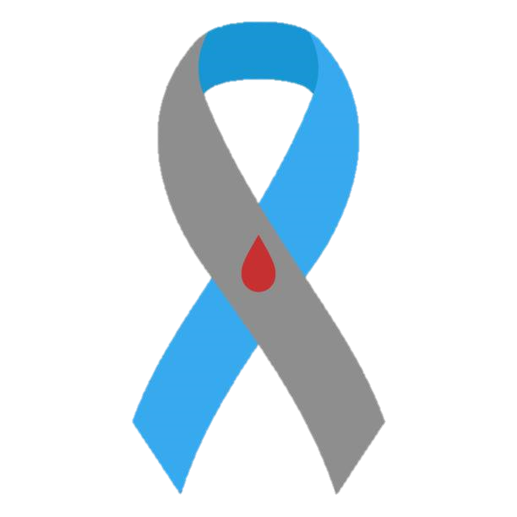




Diabetes
Awareness Month
Diabetes is a chronic medical condition where the body cannot create enough insulin or use it effectively, which regulates your blood sugar levels known as glucose
11.6%
of all adults in the U.S. have Diabetes
1 in 5
have not been diagnosed
Assessment you can
Trust
2012
9% increase in diabetes diagnoses
2022
29.5%
of all adults in the U.S. are Prediabetic
Only 2.3% of all adults in the U.S. have reported knowledge of prediabetes
8 in 10 are unaware
84%
of people with Diabetes are Type II
Type I is most often diagnosed in young adults
Type II usually develop later in a person’s life
About us:
SweetGuard stands at the forefront of preventive health, uniquely blending personal lifestyle habits with unique personality traits to forecast diabetes risk over a 10-year horizon. Our innovative approach hinges on a succinct, insightful survey, allowing us to craft risk profiles that empower individuals towards proactive health management
$413bn
Yearly medical cost of diagnosed diabetic patients
2.6
Times higher than expenditures in the absence of diabetes
Sources: CDC, Diabetes.org, BRFSS Annual survey data

Slide 2
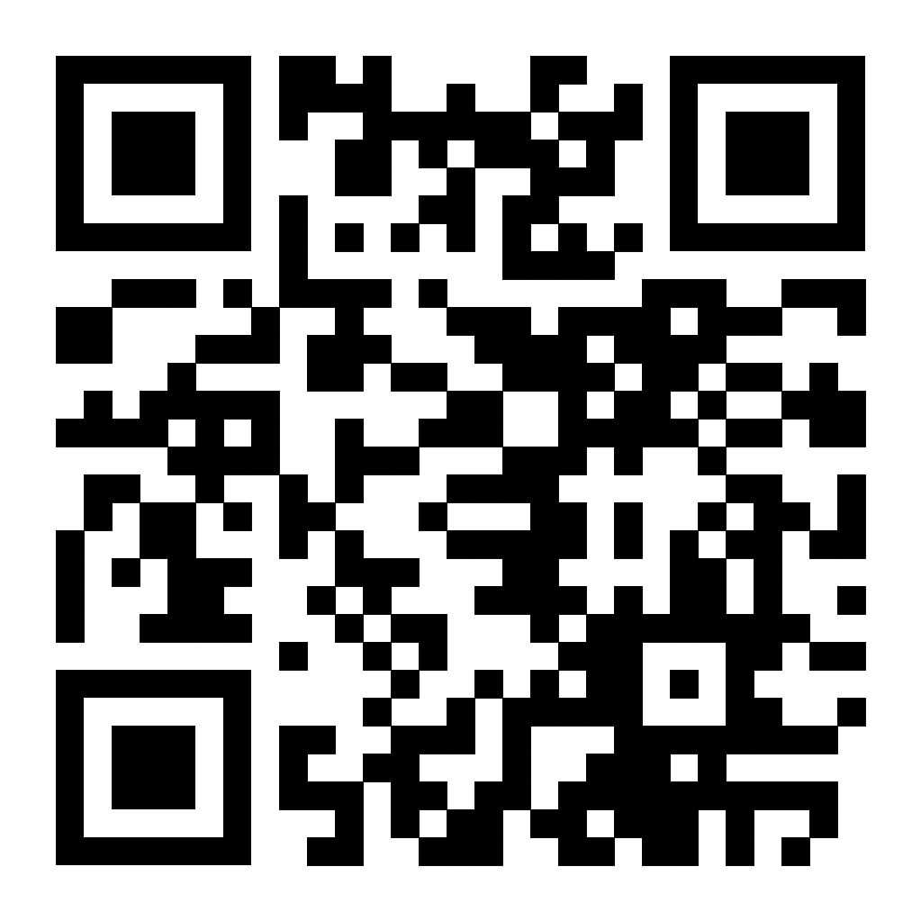
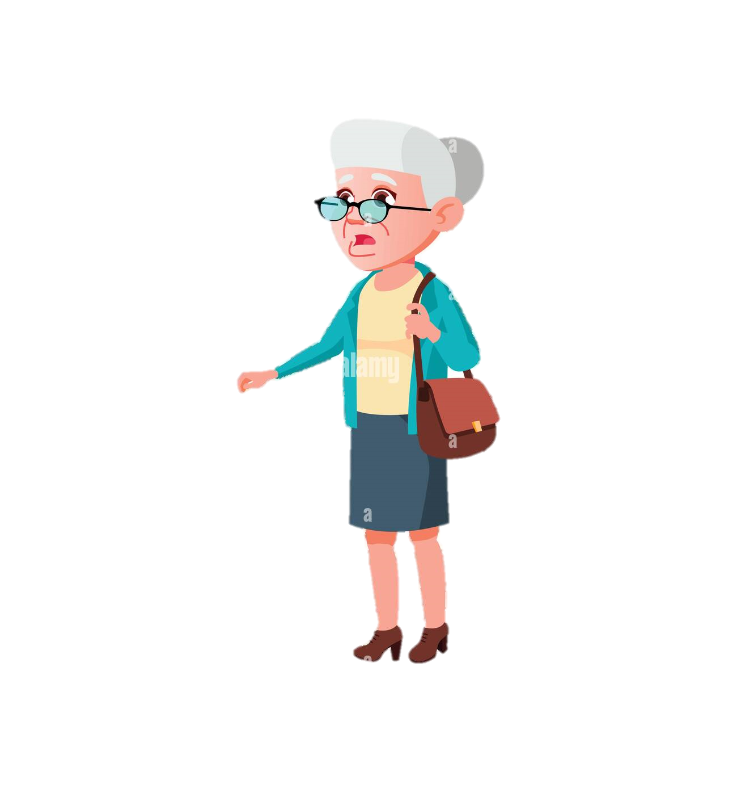
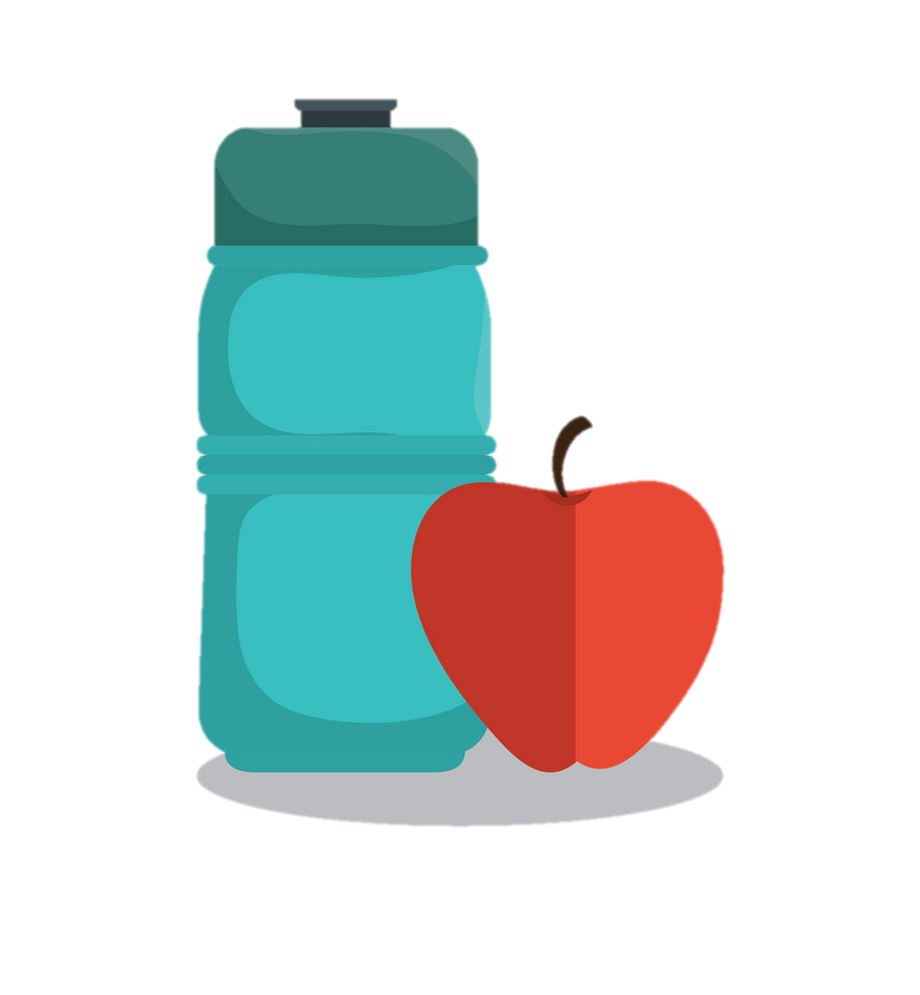

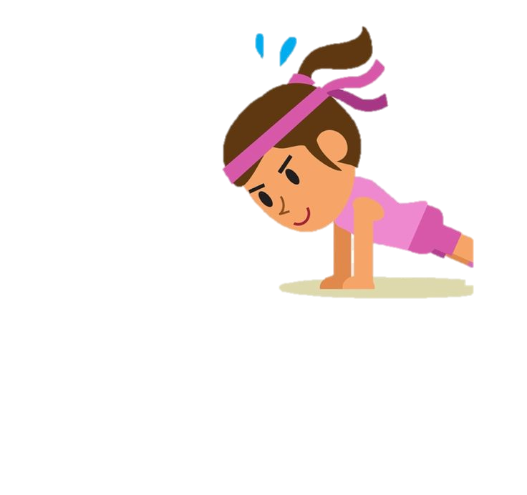


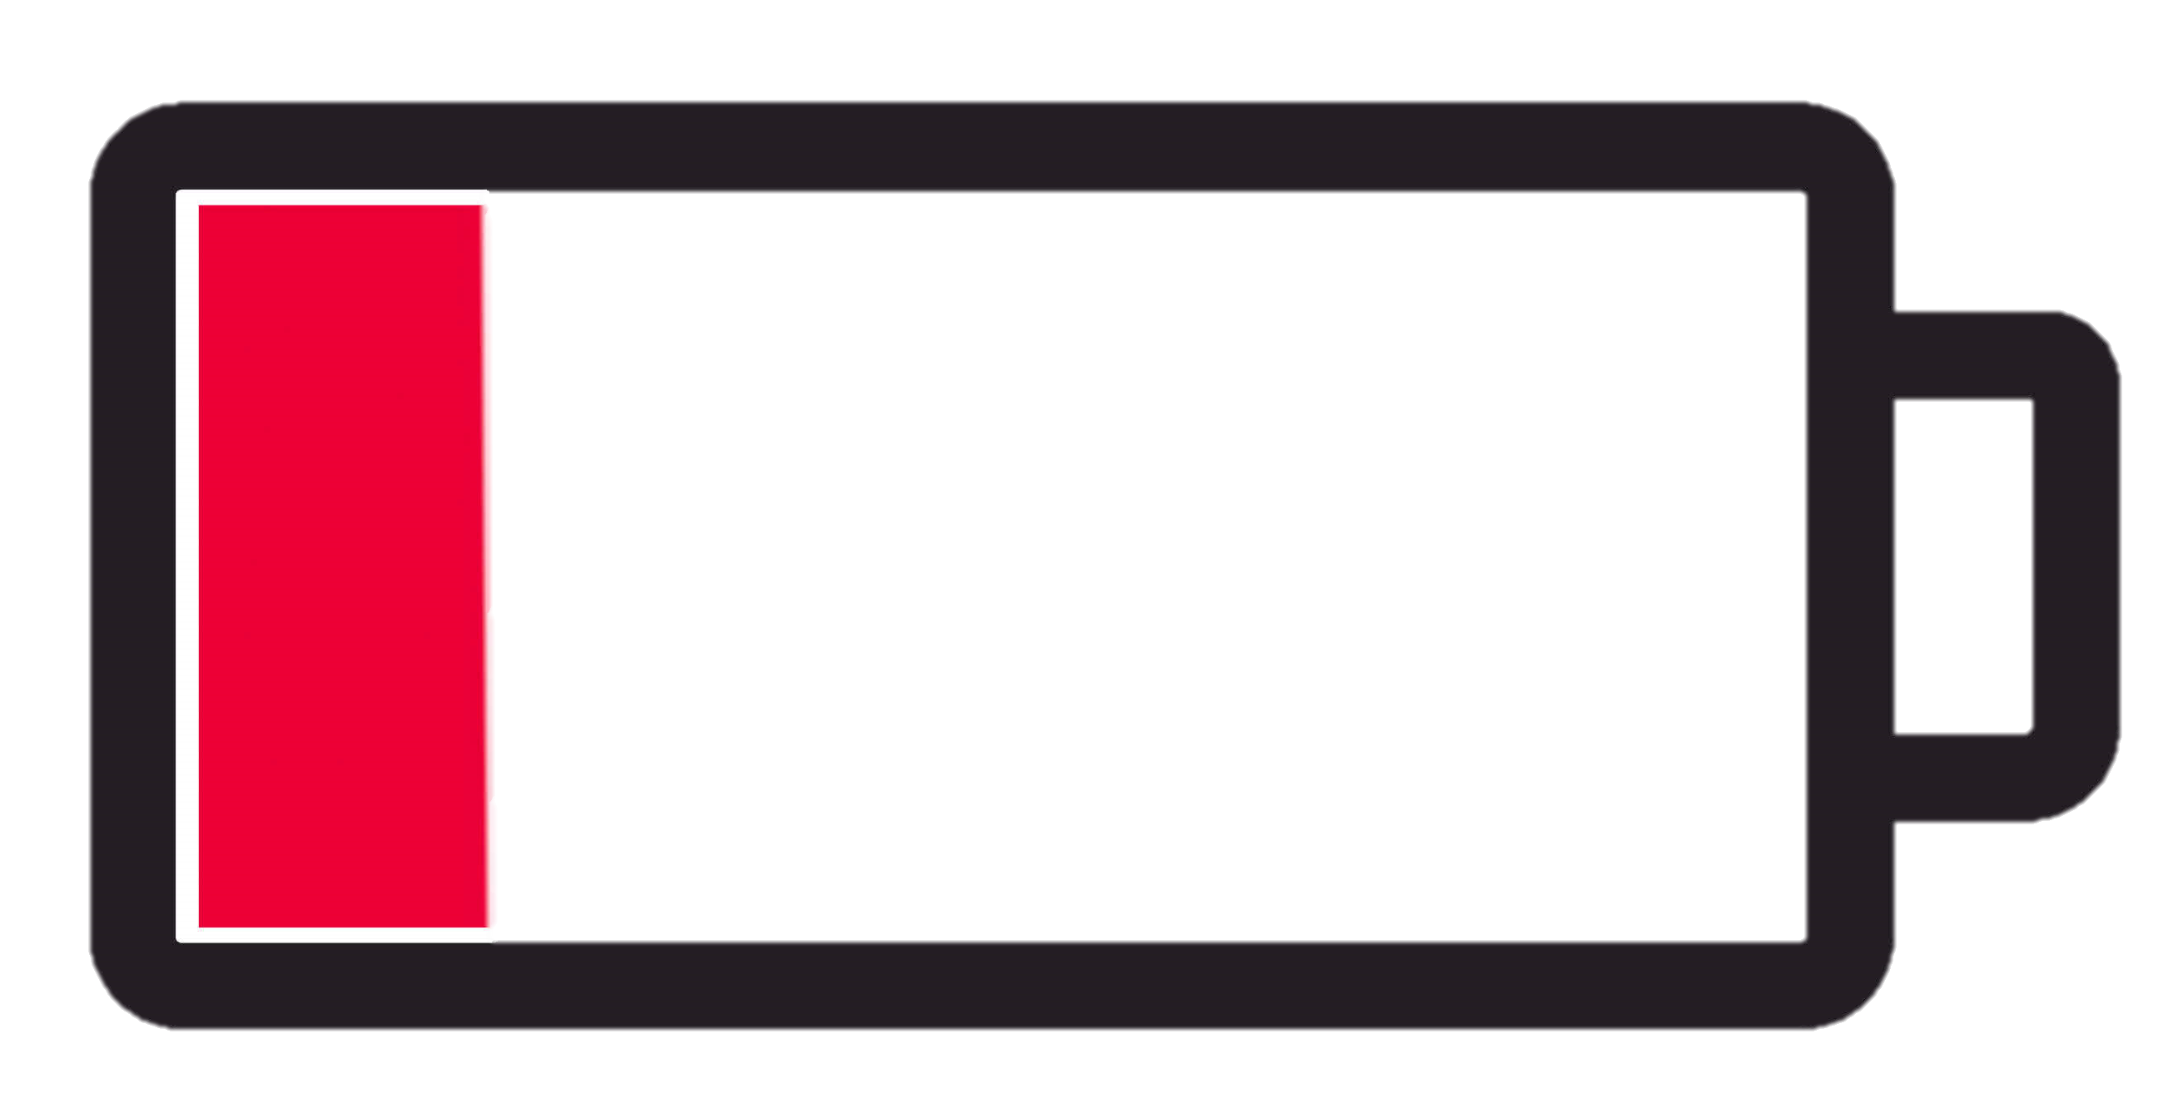

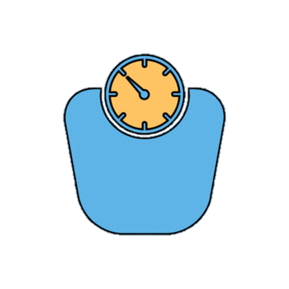
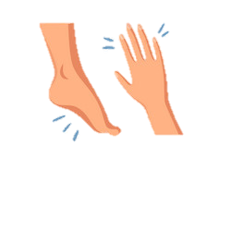
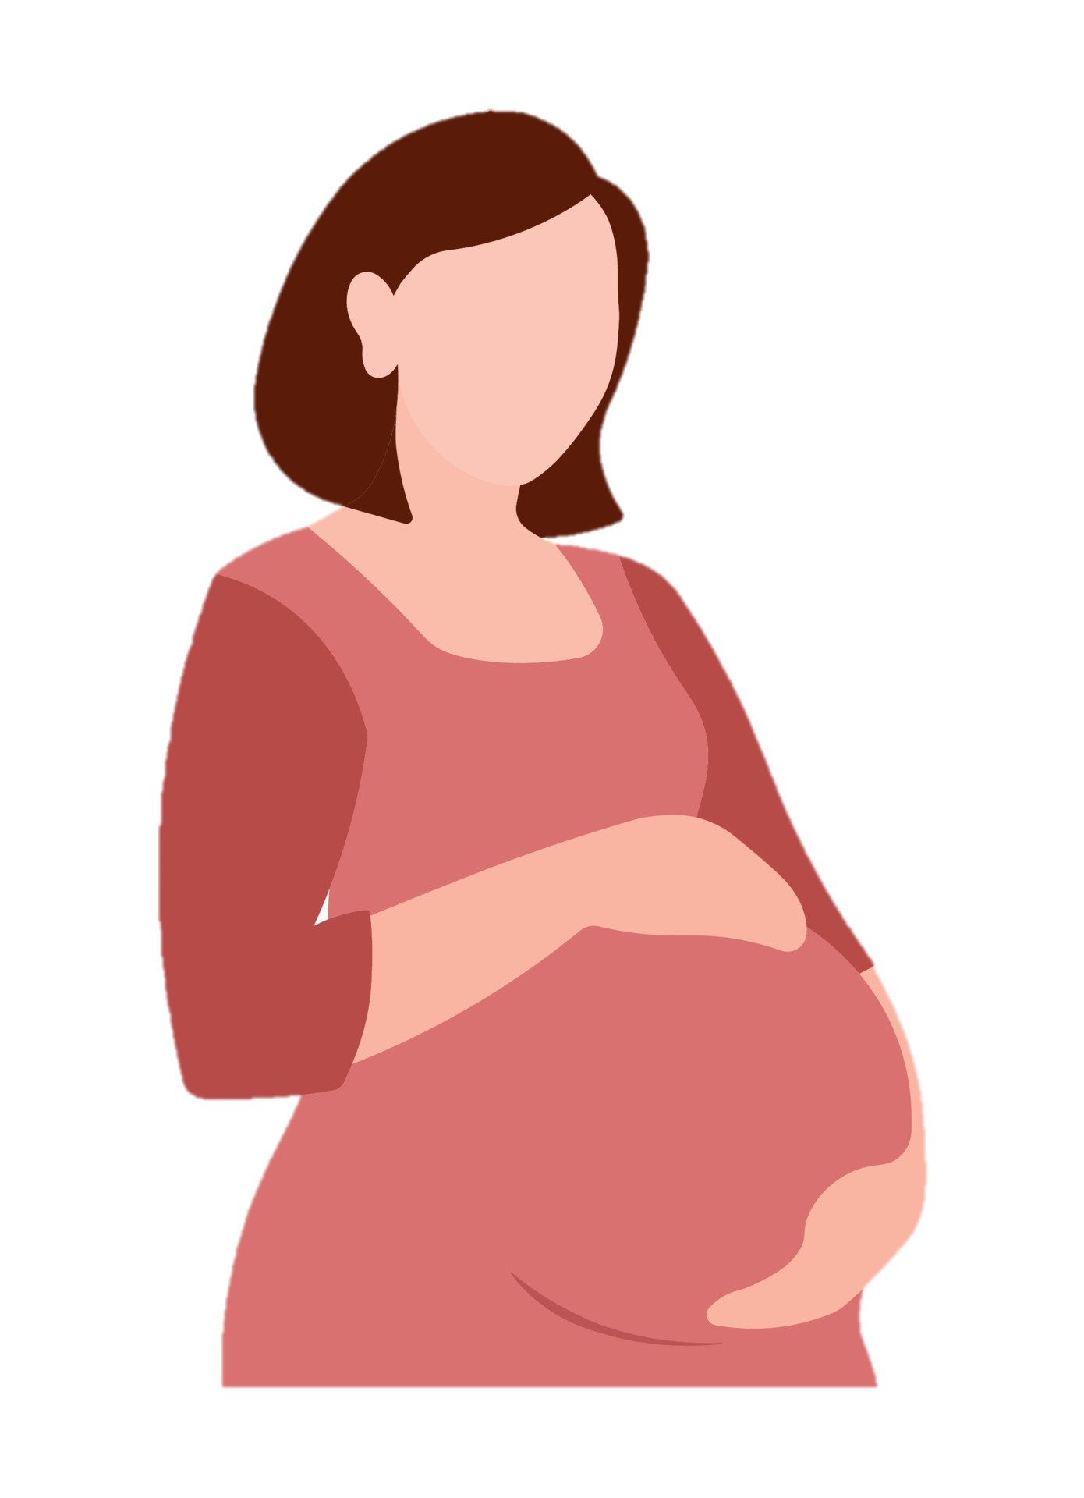



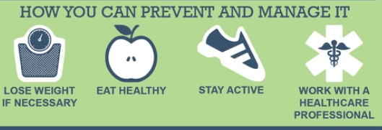




Could it be you?
Unveiling diabetic destiny
Know your risk,
Know your response
What are the SYMPTOMS?
PATIENT SEGMENTS
Check your Risk score with Sweetguard to understand your chance of diabetes over 10 years
18% above the age of 65
15% above the age of 55
Excessive hunger and thirst
Blurred vision
You’re at risk for Type-II diabetes if you:
20% people with lack of physical activity
Are overweight and/or physically inactive (Less than 3 times a week
Fatigue
Slow healing cuts
Are 45 years or older
19% with BMI more than 30
10% with BMI more than 25
Have ever had gestational diabetes (diabetes during pregnancy)
Have family history with type 2 diabetes
Sudden weight loss
Numbness in hands or feet
11% females who are pregnant
Have scored more than 15 in the Sweetguard’s risk score analyzer
Why is it DANGEROUS?
20% American Indian or Alaska Native
12% Hispanic or African Americans
Reduce the burden of Diabetes
Work with a healthcare professional to check your glucose level and blood pressure
Heart Failure
21% of diabetics suffer from Heart diseases
Stroke
25% diabetics are prone to depressive disorders
14% former or current tobacco smokers
Threaten vision and limbs
30% diabetics have difficulty walking
13% people drinking more than 5 drinks a day
Lose weight if necessary
Eat healthy and don’t smoke
Stay active

